Slide 1
Predicting Diabetes and Identifying Important Health Indicators
An Exploration of the Application of Machine Learning on the CDC’s 2014 Telephone Survey
Stephanie Boissonneault 500616408 Supervisor: Tamer Abdou Dec 9th, 2024

Slide 2
Introduction
Dataset: Centers for Disease Control and Prevention 2014 Behavioral Risk Factor Surveillance System Survey
Features: 22 Health Indicators
Observations: 253,680 Americans
Target Variable: No Diabetes/Pregnancy Only, Pre Diabetes, Diabetes
Data Analysis Techniques
Question 1 : Apriori Algorithm and Association Rules
Question 2 : Feature Selection Models
Question 3 : Predictive Machine Learning Models
Question 4 : Principal Component Analysis
Goal: Make Recommendations for Clinical Practice Settings
(Teboul, 2021; Centers for Disease Control and Prevention, 2015)

Slide 3
Q1: What health conditions and lifestyle factors commonly occur together in individuals with different diabetes diagnoses?

Slide 4
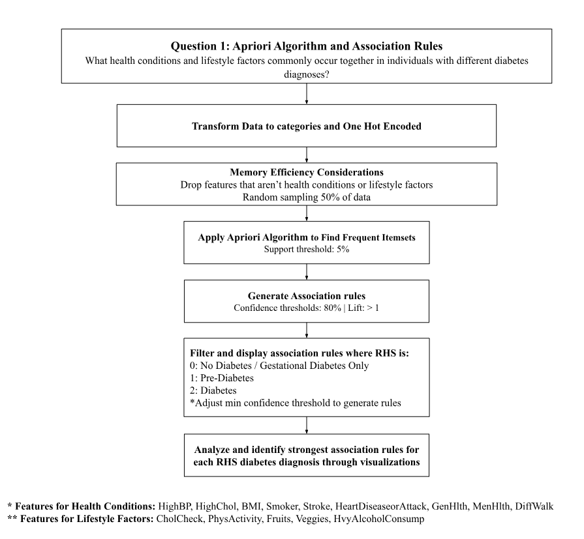
Q1: Methods
Notes:
The literature search did not reveal any previous studies that apply the apriori algorithm and generate association rules. This method was however introduced to identify itemsets and their association and ability to predict the diabetes class.

Slide 5
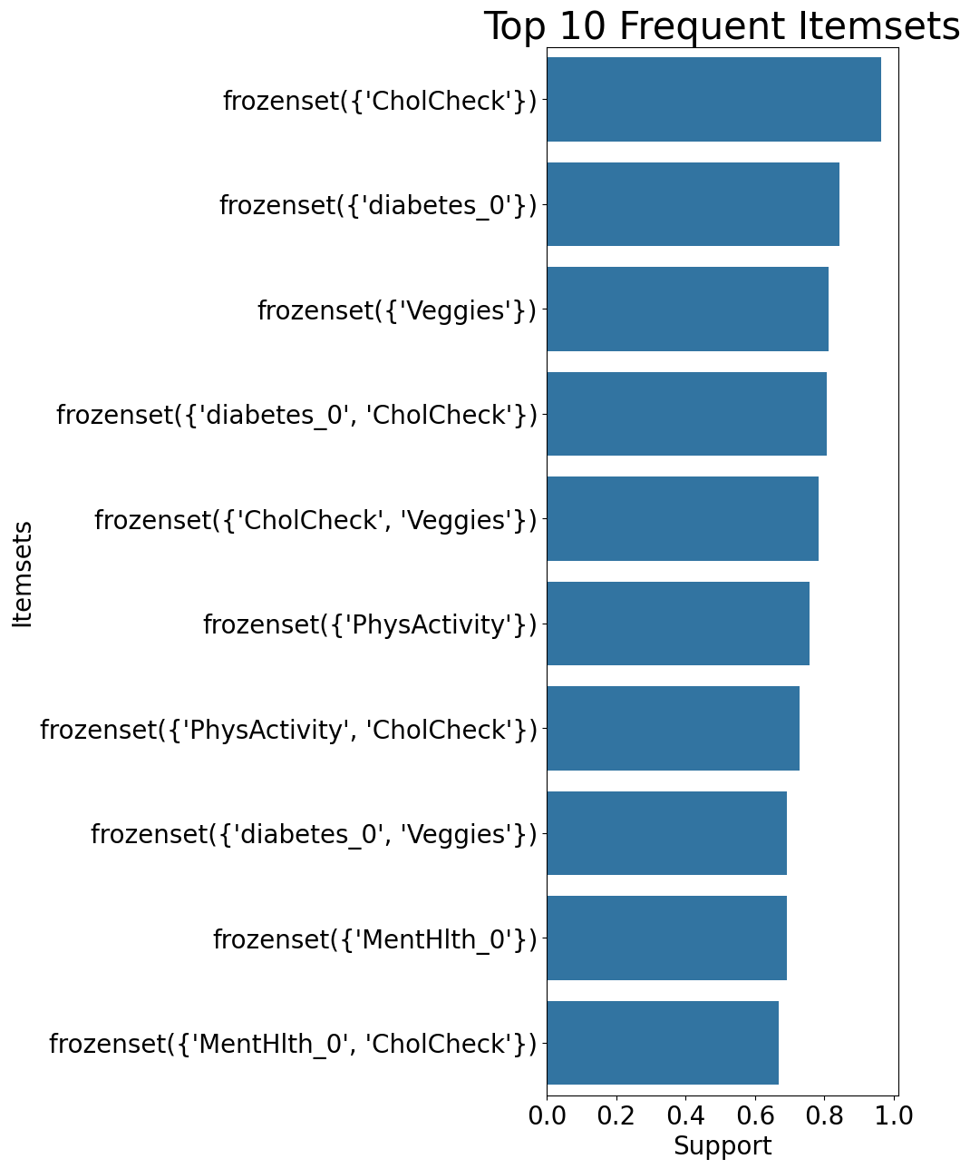
Q1: Methods
Data: Random Sample (50%) of One Hot Encoded Health Conditions and Lifestyle Factors Data
Apriori Algorithm for Frequent Itemsets
- support 0.10

Slide 6
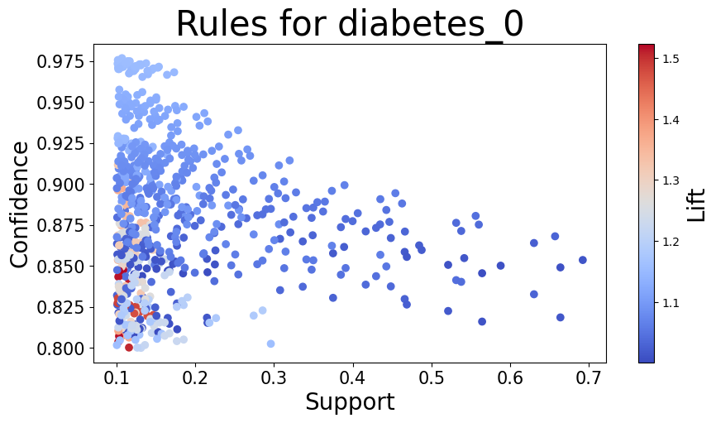
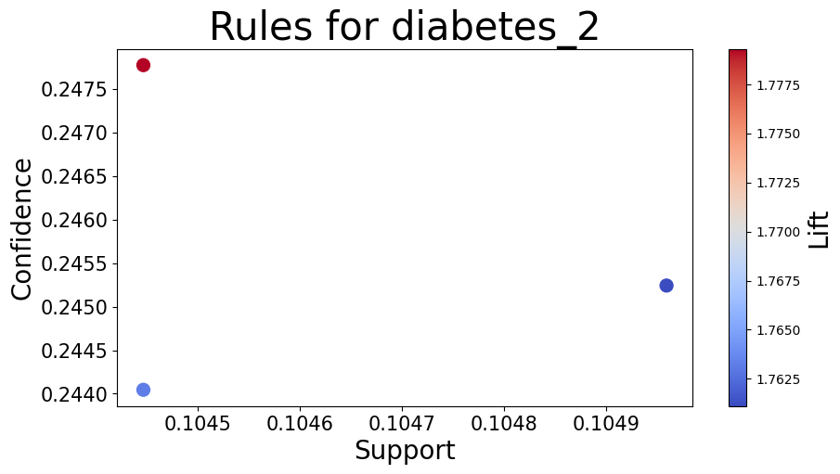
Q1: Association Rules for RHS Diagnosis
No diabetes/Pregnancy Only (diabetes_0)
- min confidence = 0.8, Lift >1
697 results
Pre Diabetes (diabetes_1)
-min confidence = 0.1, Lift > 1
No results
Diabetes (diabetes_2)
-min confidence = 0.2, Lift >1
3 results

Slide 7
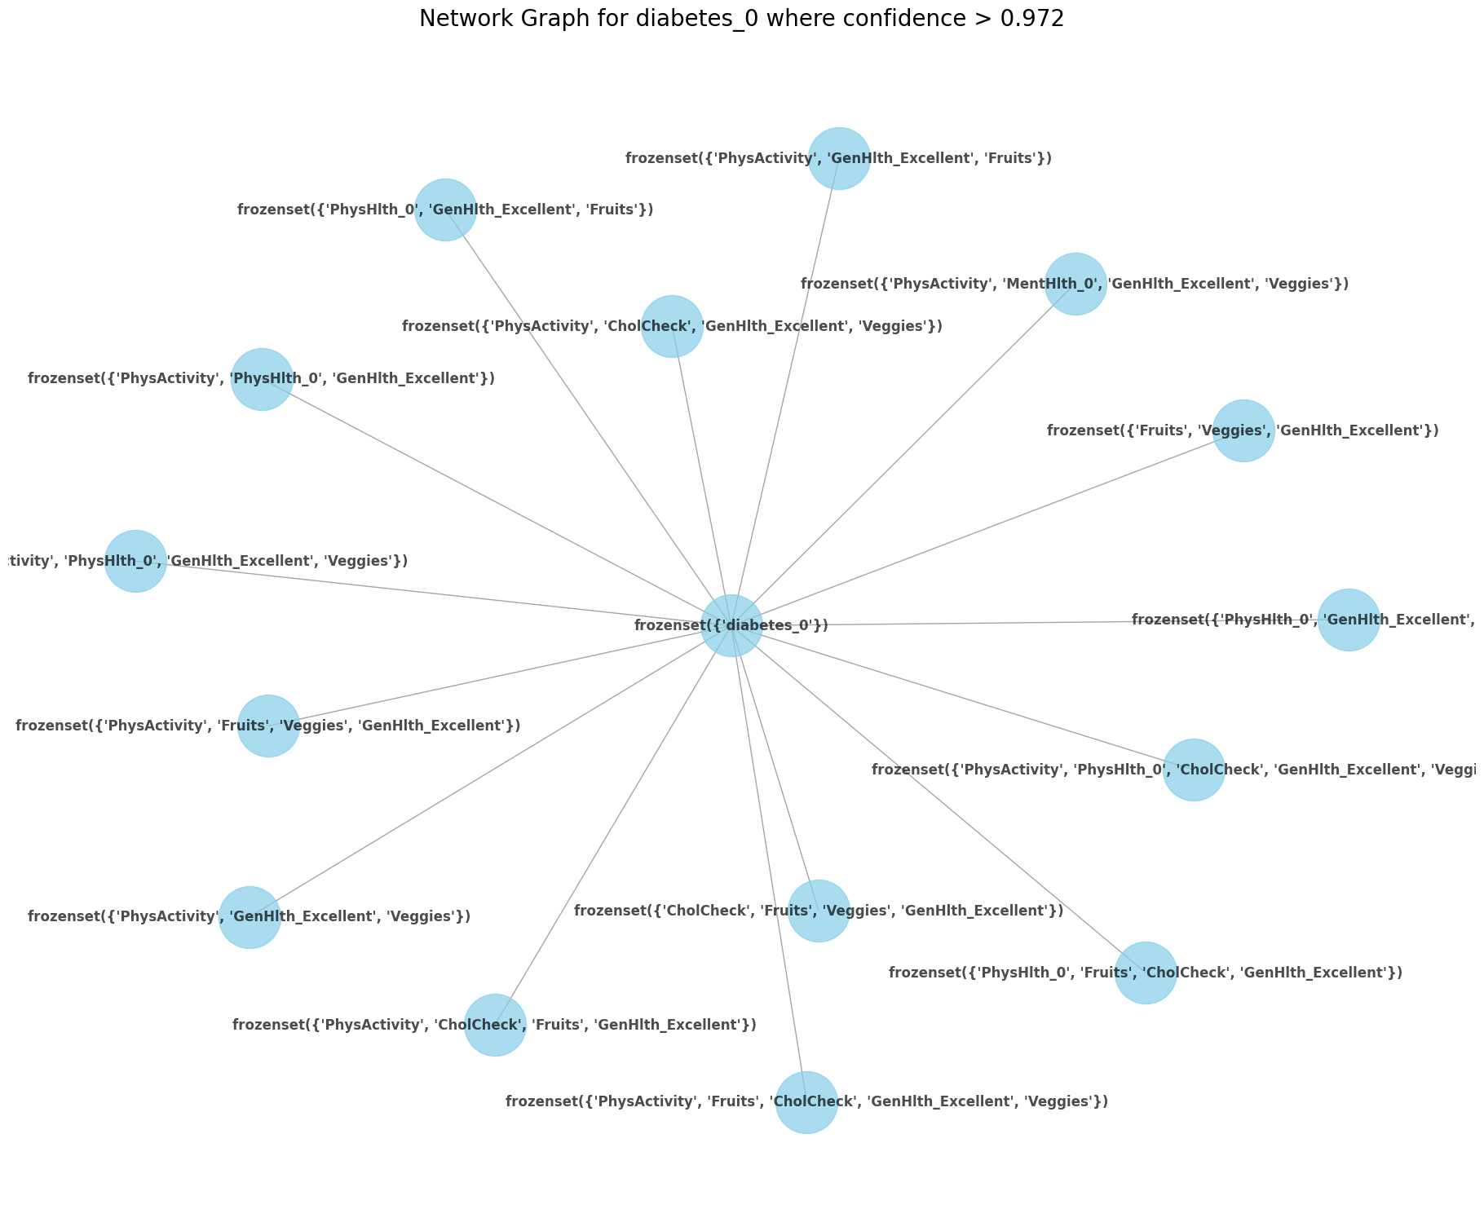
Q1: Association Rules for RHS No Diabetes
Notes:
The itemsets that served as the highest predictors of no diabetes were ‘’GenHlth_Excellent, PhysActivity, Fruits, Veggies,’’ and ‘’GenHlth_Excellent, PhysActivity, Fruits, Veggies, CholCheck’’
The low support of 0.10 and the high confidence level of 97.5 indicate that although this combination of health indicators does not occur very frequently in the population (it only appeared in 10% of the dataset), together they are highly associated with health and are high predictors of health (or having no diabetes or diabetes only during pregnancy).
These insights can be used by clinicians when making recommendations as to what combination of lifestyle factors to adopt to stay in good health and avoid diabetes.

Slide 8
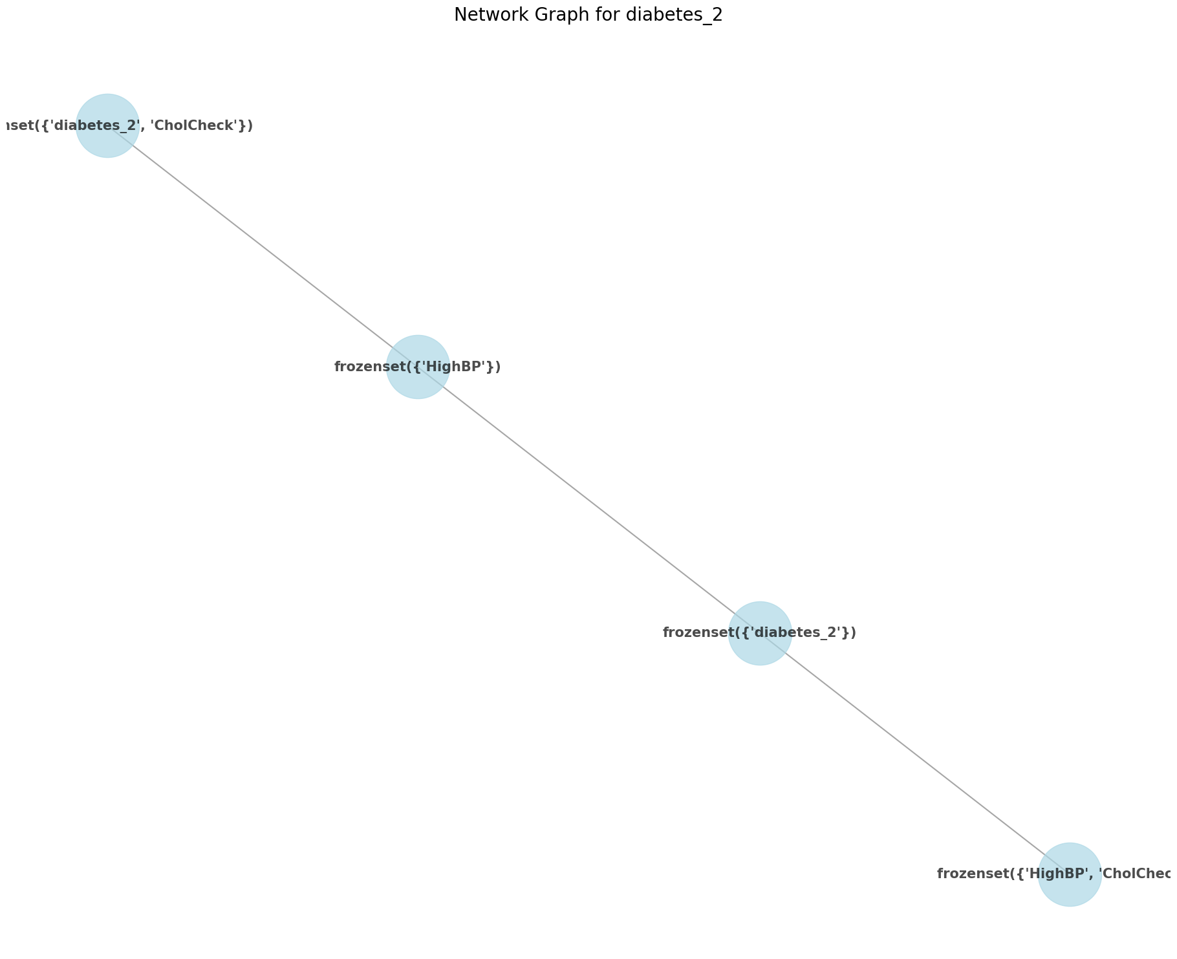
Q1: Association Rules for RHS Diabetes
 | antecedents | consequents | support | confidence | lift
17 | HighBP | diabetes_2 | 0.104959 | 0.245243 | 1.761116
305 | HighBP, CholCheck | diabetes_2 | 0.104447 | 0.247774 | 1.779296
307 | HighBP | diabetes_2, CholCheck | 0.104447 | 0.244045 | 1.763198
Notes:
Only 3 association rules were generated revealing an association between diabetes and high blood pressure or high blood pressure in combination with a cholesterol check.
The association has a very low confidence level of 24% indicating that the itemset is a weak predictor of the diabetes diagnosis.
The high lift value of 1.7 does not provide any further insights that could be extracted as the high value is only an amplified result due to the combination of both low support and confidence.

Slide 9
Q2: What health indicators are considered most important for disease prediction?

Slide 10
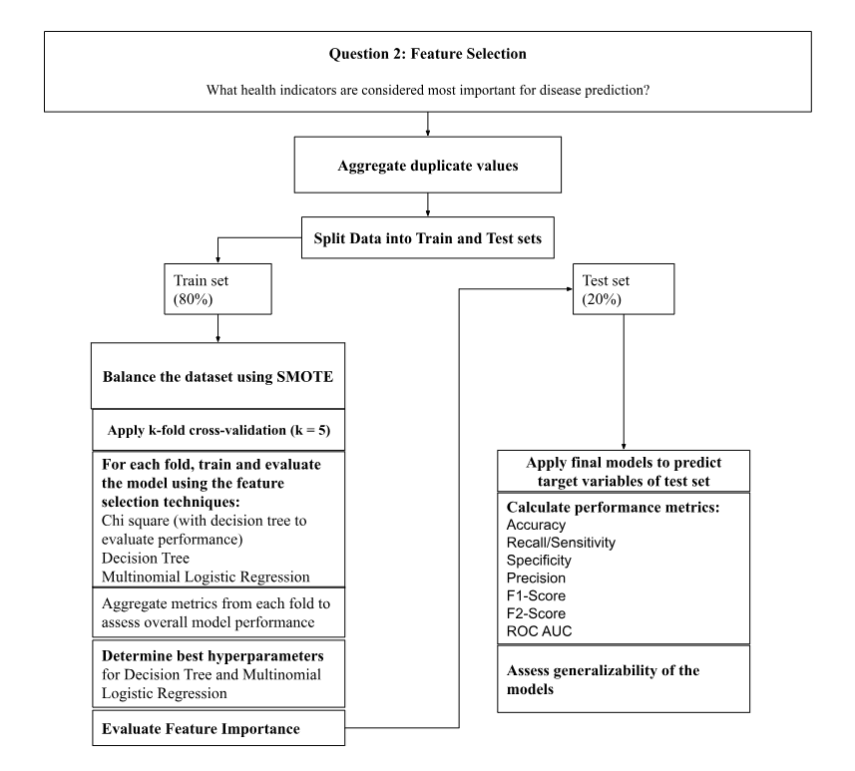
Q2: Methods
Notes:
To answer questions 2, I decided to compare the performance metrics and generalizability of three different feature selection techniques; The feature selection techniques chi-square (filter method), decision tree (wrapper method), and multinomial logistic regression(embedded method using penalty L2 and regularization strength C).
Used synthetic minority over sampling on train set to reduce bias from unbalanced classes
Used k-fold cross validation (k=5) to reduce bias that can occur when feature selection is applied to a single split
Use GridSearchCV for hyperparameter tuning because it tests all possible parameters combinations to select the best

Slide 11
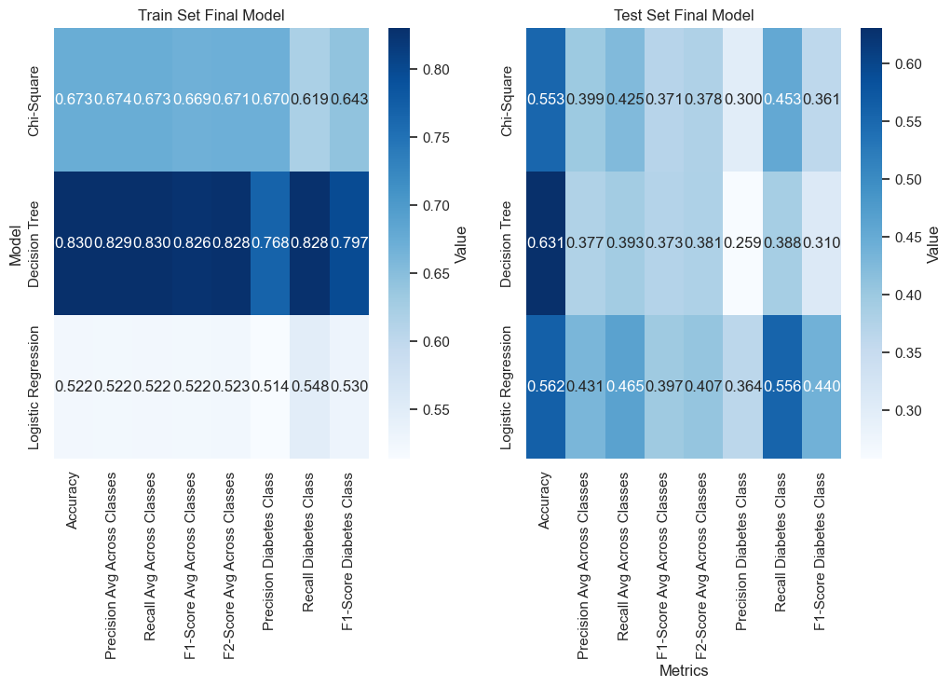
Q2: Final Model Performance Metrics
Notes:
While the decision tree model had very high scores across all performance metrics during model training, there was a large drop in score of about 0.5 for almost all features, indicating that the the model may have overfitted on the train set. It was therefore not considered generalizable. The logistic regression model overall performed best on the train set and had the most stability in performance metrics between the train and the test set. The logistic regression model had the highest scores across performance metrics on the test set except for accuracy.

Slide 12
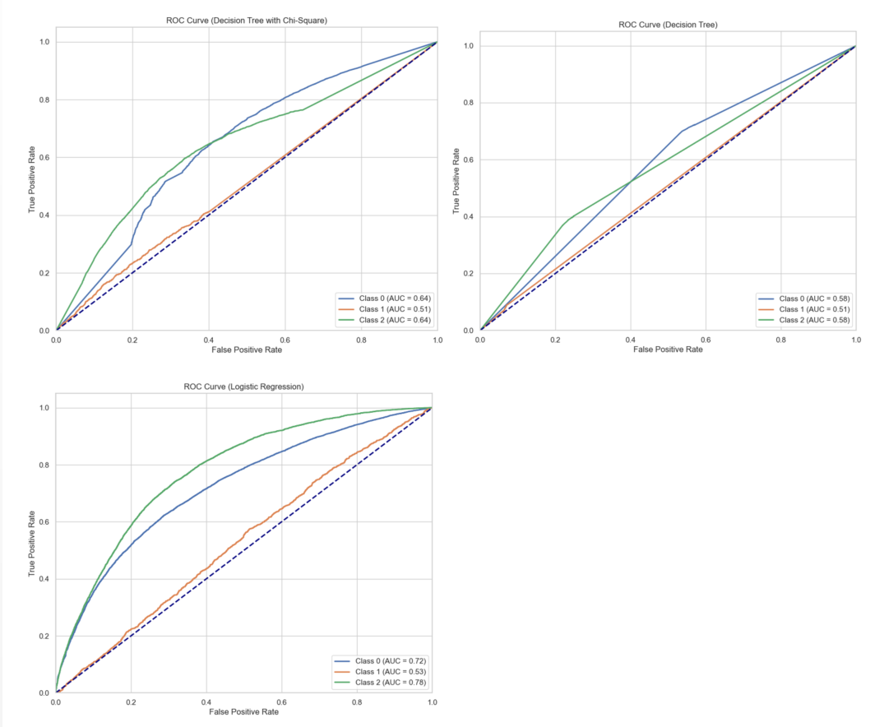
Q2: Final Model on Test Set ROC AUC
The Final Logistic Regression Model has the greatest area above the curve.
Notes:
The logistic model had the greeted area under the curve of the receiver operating characteristic indicating it is the best model at distinguishing between positive and negatives. It was also the model with the highest recall to ensure that no diagnosis goes missed.

Slide 13
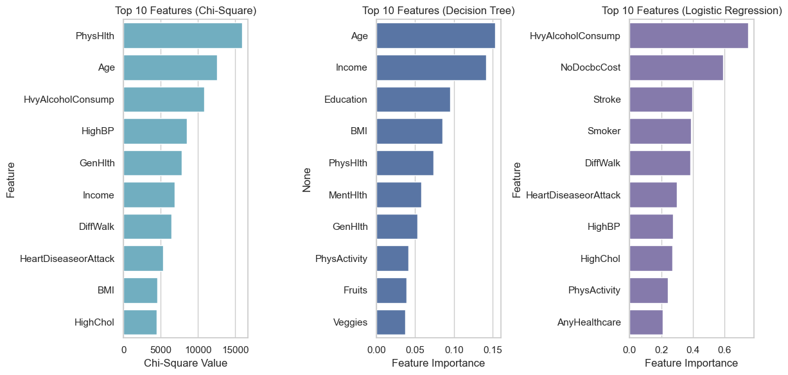
Q2: Top 10 Features Selection By Final Models for both Train and Test Sets
Notes:
Decision tree and chi square were stable and selected the same features across each fold. The logistic regression had more fluctuations between k folds on the train set.
Features selected by the final model were the same for the train set and the test set across models.

Slide 14
Comparison to Literature Review
Combination of of lifestyle, socioeconomic, and diagnostic data generally produced better predictive models ✔ (Fregoso-Aparicio et al., 2021).
Common diabetes predictors are Body mass index (BMI) and illness (Kumar et al., 2023) ✔
Age, obesity, and blood glucose are common predictors, and physical activity is rarely selected (Kodama et al.,2022) ✔

Slide 15
Q3: What machine learning models best predict diabetes based on effectiveness, efficiency, stability, and interpretability?

Slide 16
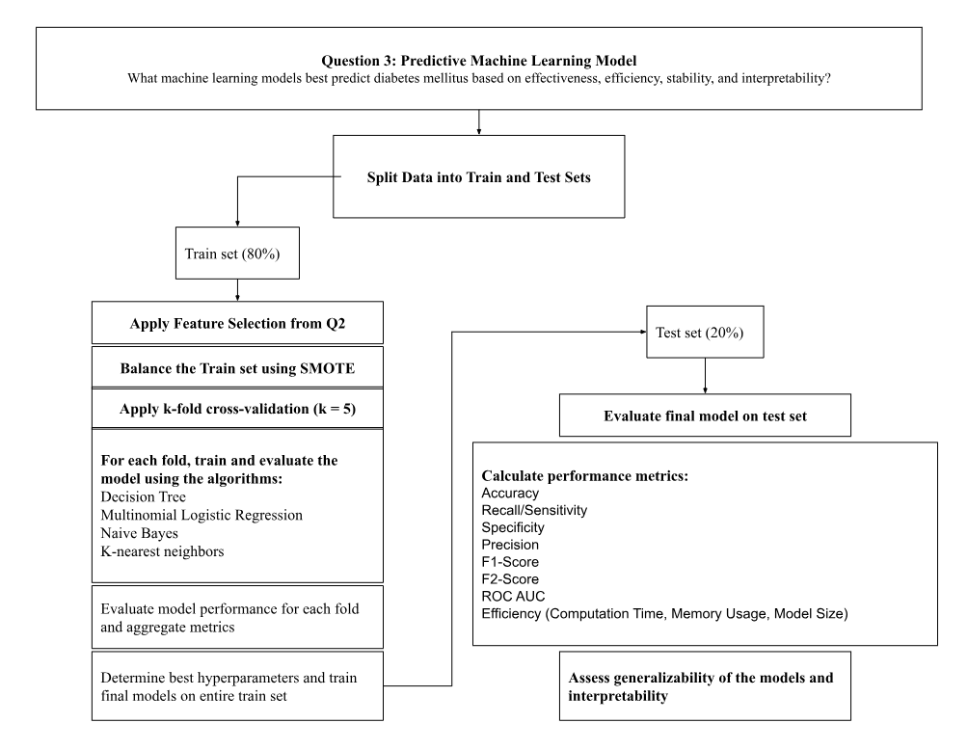
Q3: Method
Notes:
The selected machine learning models for this study were four of the listed common machine learning algorithms identified during the literature search (Abdulazeem et al., 2023; Fregoso-Aparico et al., 2021; Kodama et al., 2022; Kumar et al., 2023; Olusanya et al., 2022; Zanelli et al., 2022)
Similar to question 2, I used SMOTE for oversampling, k-fold cross validation (k=5) and hyperparameter tuning using GridSearch
Feature selection was also applied to on the train set to select top 10 features
Columns not one of the top 10 features dropped in train and test set for memory efficiency

Slide 17
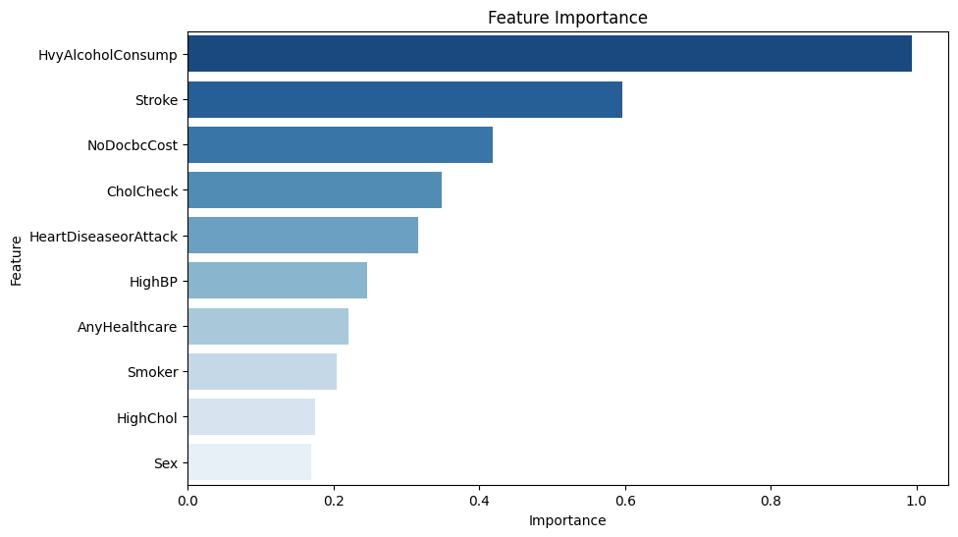
Q3: Interpreted Findings
Notes:
Final Logistic Regression Model Parameters: LogisticRegression(multi_class='multinomial', solver='lbfgs', C=0.01, penalty='l2')
Selected features slightly different than those from Question 2

Slide 18
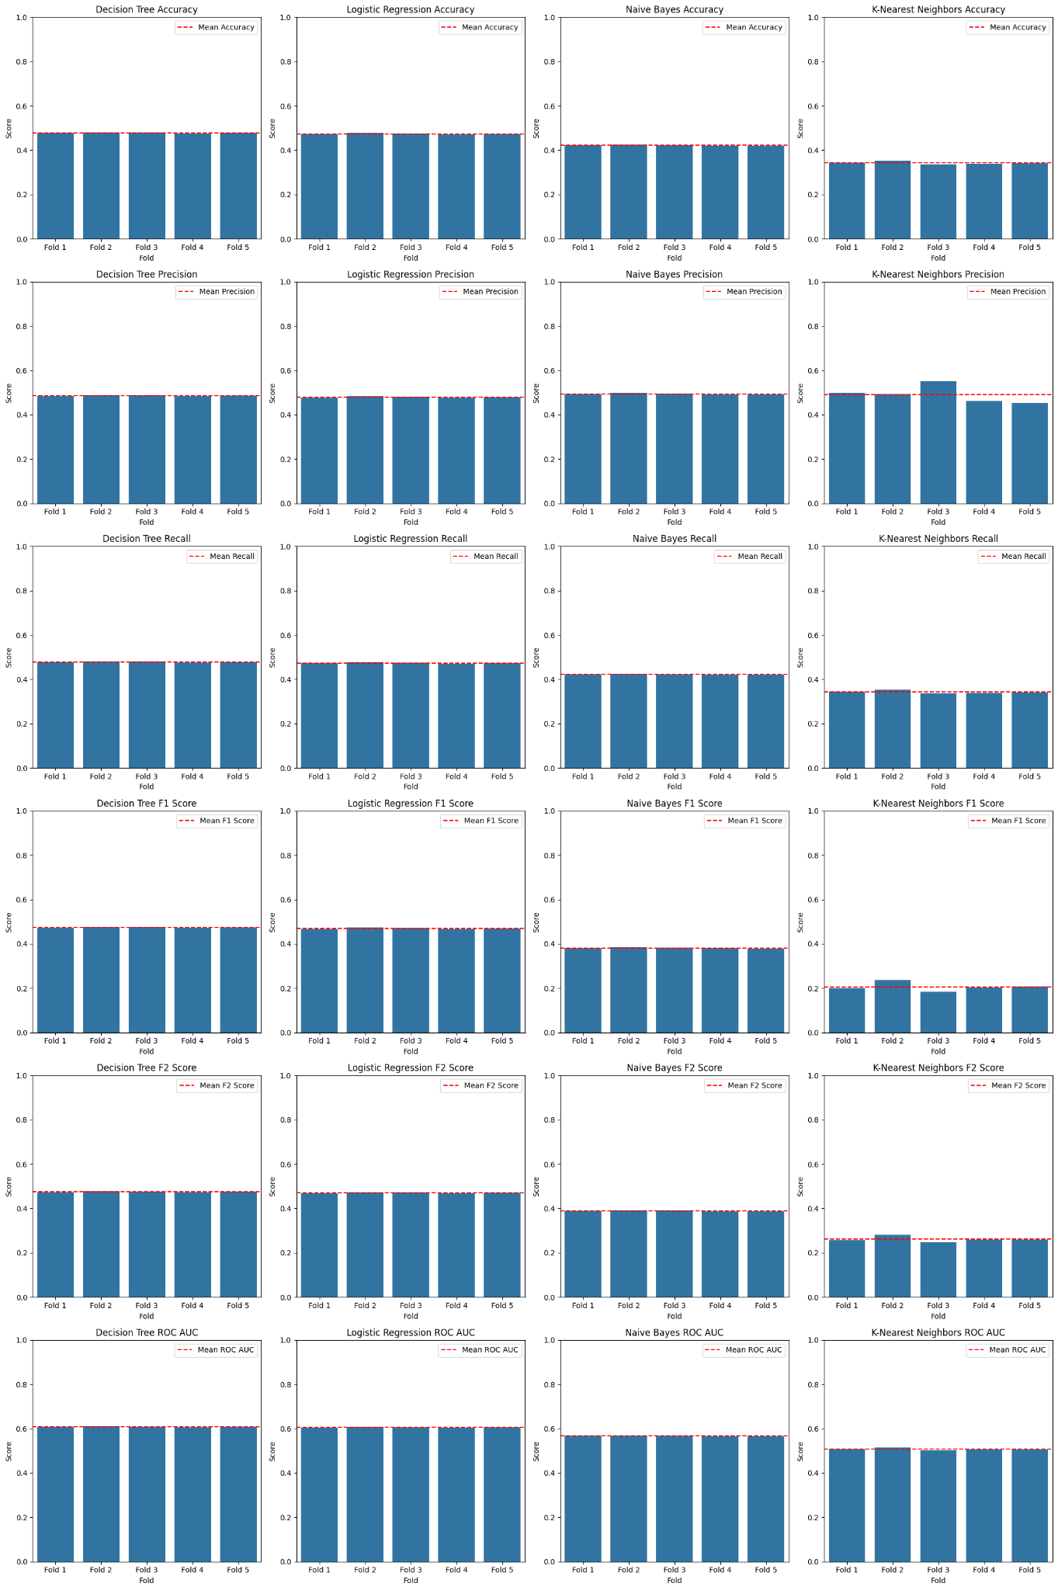
Q3: Interpreted Findings
The KNN Model had the
greatest variation in
performance metrics
across folds.
Performance Metrics
for all other models
appeared stable across
folds
Notes:
All models stable between folds except for KNN

Slide 19
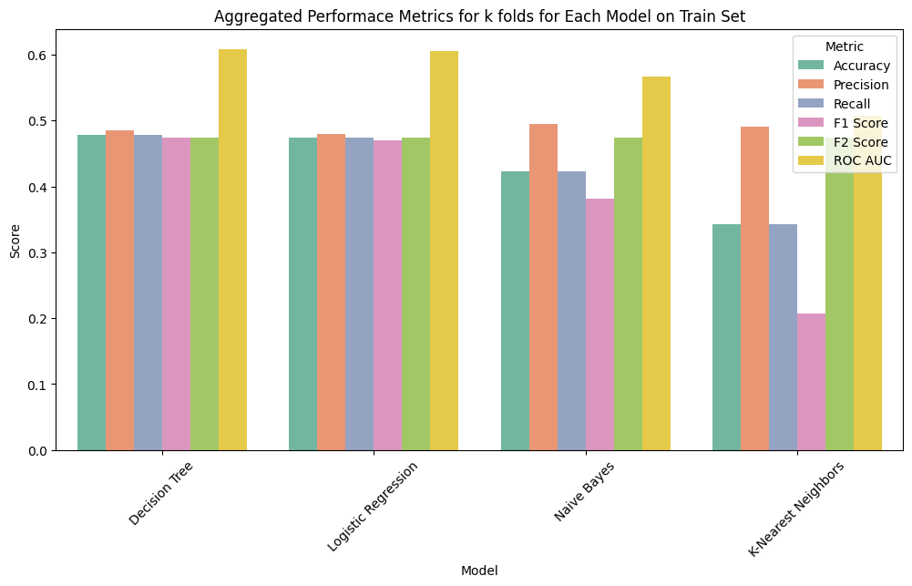
Q3: Average Performance Metrics on Train Set
Notes:
Decision Tree and Logistic Regression had best overall performance metrics for averages across class on train set.

Slide 20
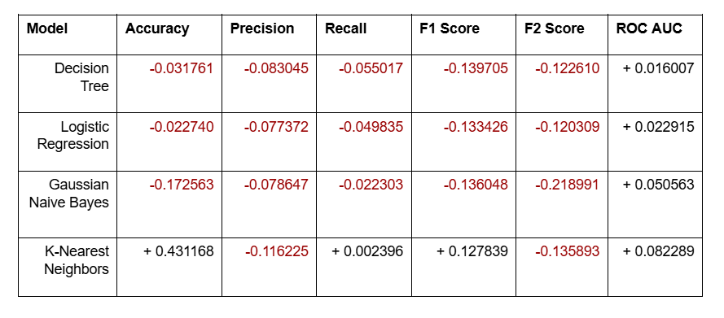
Q3: Difference in Performance Metrics
Notes:
Most models experienced a drop in score for performance metrics across the board except for ROC AUC.

Slide 21
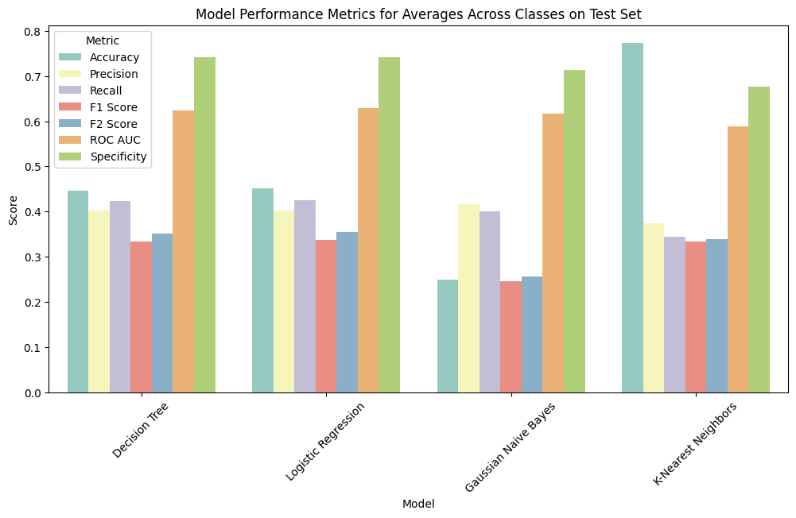
Q3: Performance Metrics on Test Set
Notes:
Decision Tree and Logistic regression still have best recall, F2 score, and ROC AUC

Slide 22
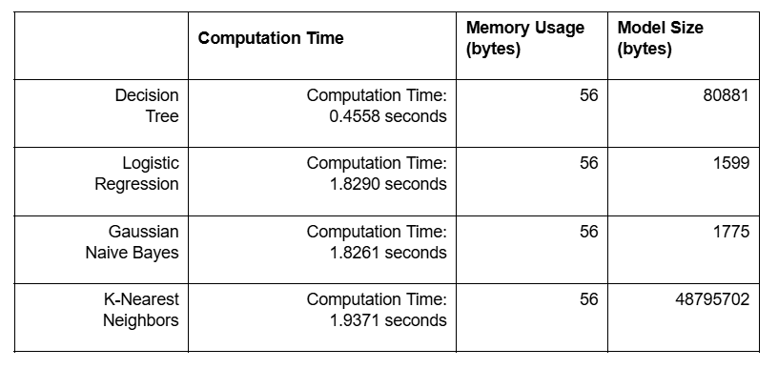
Q3: Models Efficiency on Test Set
Notes:
The Decision tree model had the lowest computational time and the logistic Regression model was the smallest size. The KNN model was the least efficient model overall.

Slide 23
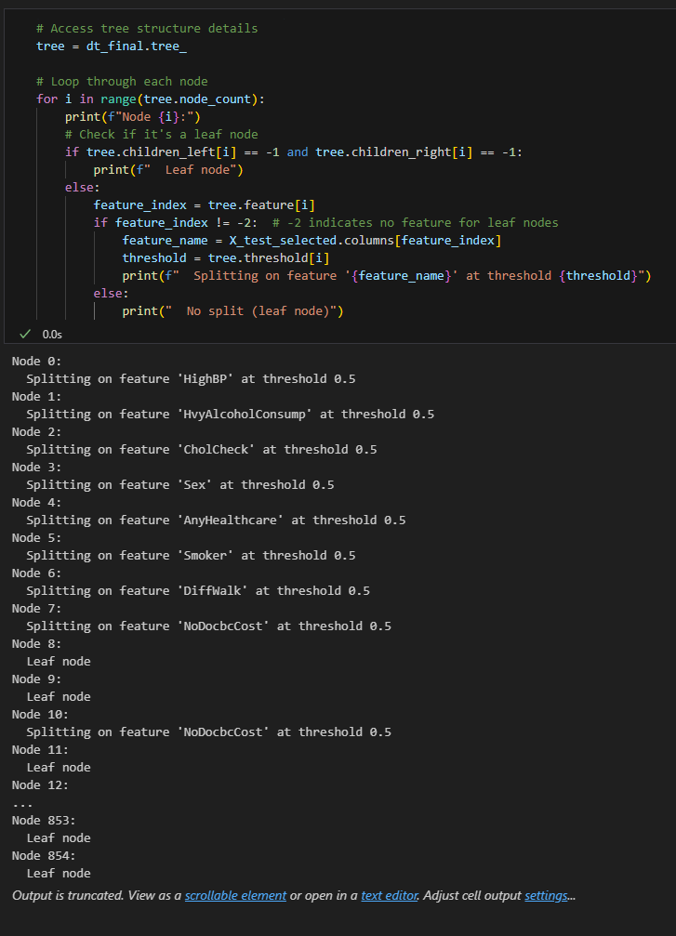
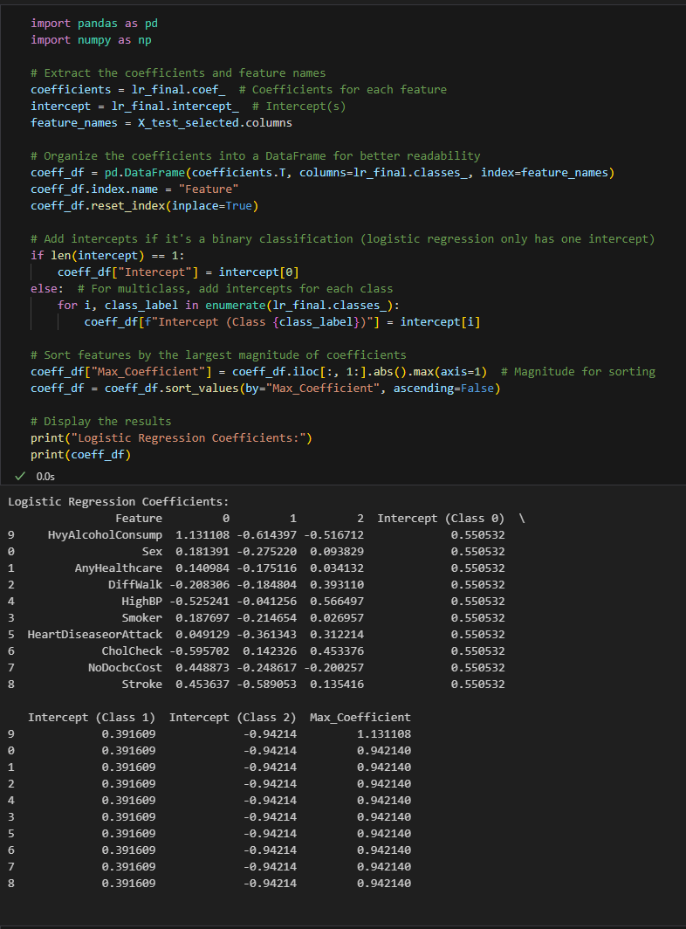
Q3: Model Interpretability
Decision Tree Model
Logistic Regression Model
Notes:
Logistic Regression model is more easily interpretable because the model size is smaller and easily displays the coefficients for each feature which determine the weight of the features for helping predict the diabetes class. The decision tree model is very large and may take more time to interpretate.

Slide 24
Comparison to Literature Review
Decision tree models as the most common and best-performing models based on performance metrics ✔ (Abdulazeem et al., 2023; Fregoso-Aparicio et al., 2021; Olusanya et al., 2022)
Non-logistic regression models were found to perform better than logistic regression models ❌
(Zhang et al., 2022)

Slide 25
Q4: What patterns can be uncovered in population subsets based on age,
sex, and BMI?

Slide 26
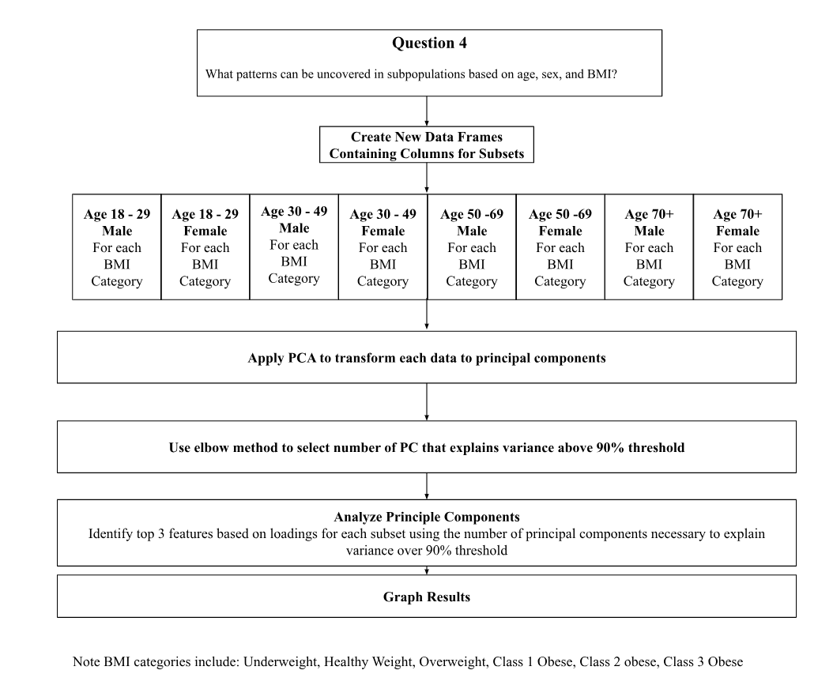
Q4: Method

Slide 27
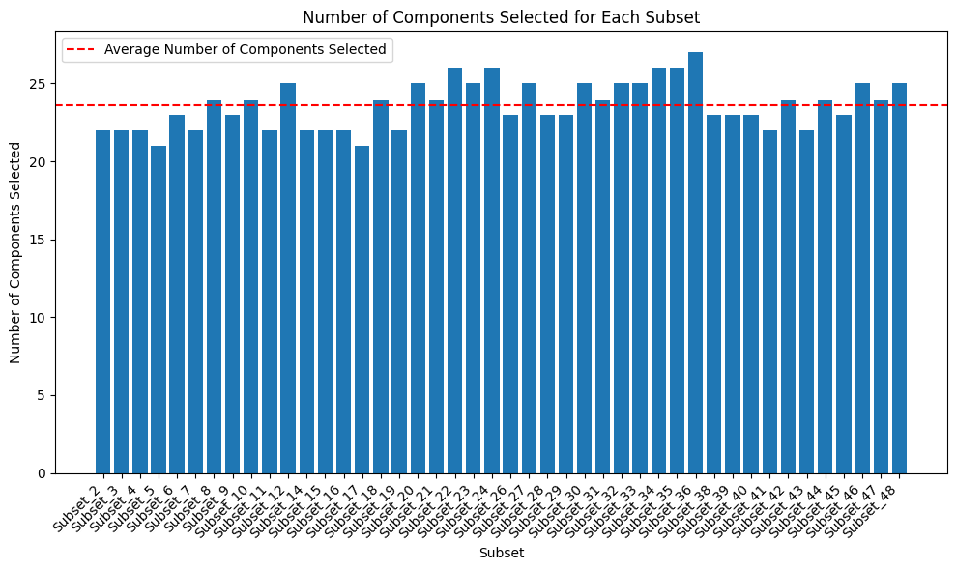
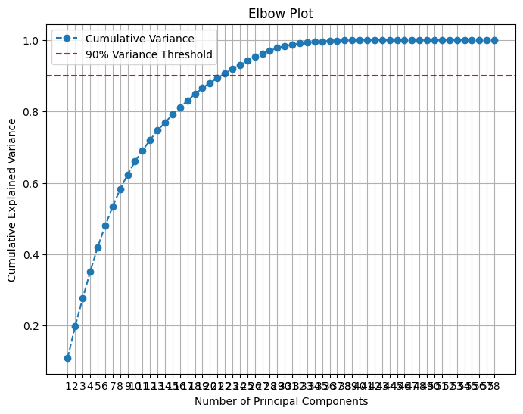
Q4: Number of Principal Components Selected to Reach 90% Threshold for Explained Variance
Average #PC: 23.61
Notes:
The average number of PC’s needed by each subject to explain 90% of the variance in the class was 23.61

Slide 28
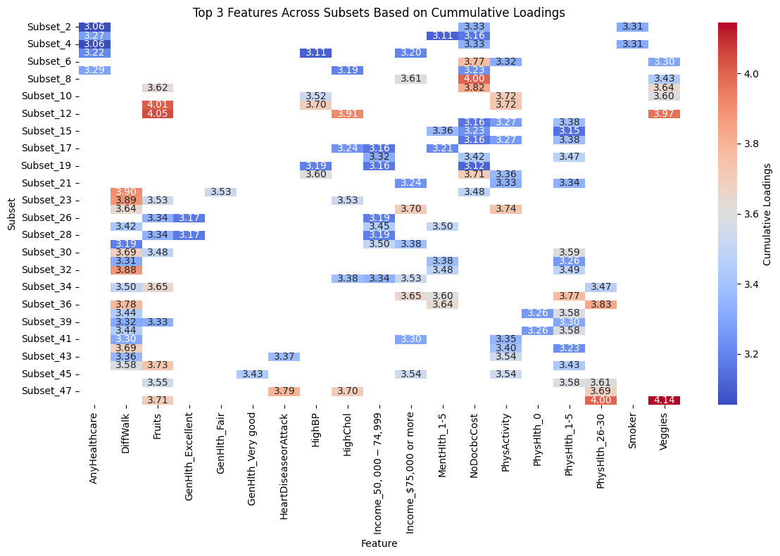
Q4: Top 3 Features Across Subsets
Notes:
The top 3 features across subsets based on cumulative loadings for the total number of PC needed to reach a threshold of 90% explained variance were extracted and plotted in a heat map.
Loadings: weight how much each feature contributes to the principal component

Slide 29
Q4: Younger populations
Notes:
Health indicators such as access to health coverage or accessed healthcare based on cost, and being told they have high blood pressure appear to have a greater influence on explaining 90% of the variance in the diabetes diagnosis outcomes in younger populations ages 18 to 29 and 18 to 49 respectively.
These observations may be explained by whether or not younger individuals access preventative care to catch and identify early signs and symptoms of the disease before it progresses to become a greater issue. Programs and campaigns targeted at younger populations to help increase their access to preventative and diagnostic services is therefore important. While canada has provincial healthcare coverage, this problem could be looked at from the perspective of ensuring sufficient doctors are available to the population, as Canada has many waiting lists for family doctors.

Slide 30
Q4: Overweight Obese
Notes:
Whether blood cholesterol is determined to be high is more influential in overweight and obese males.
Whether an individual has experienced heart disease or a heart attack proves to be most influential in males ages 65 and over with obesity.
Answers to whether or not an individual smokes only seemed to have a greater influence in explaining variance in the diabetes outcome in healthy weight and underweight females ages 18 to 29.

Slide 31
Q4: Older Populations
Notes:
Health indicators such as reported difficulty walking or climbing stairs, as well as reported levels of physical health appear to have a greater influence on explaining the variance in the diabetes outcomes in populations above the age of 30. This observation may be explained by the common increase in health complications or accumulated injuries that arise later in life.

Slide 32
Summary of Project’s Accomplishments
Question 1 : Recommended for combination of lifestyle factors to maintain health
Question 2 : Identified frequently selected features and best feature selection model
Question 3 : Identified Decision Tree model and Logistic Regression as best models for diabetes prediction
Question 4 : Recommended population subset based recommendations for considerations in screening questionnaires

Slide 33
Limitations & Challenges
Dataset: American data limited to lifestyle factors, health conditions, and select demographics
Limited data available for diabetes class for association rules
Select subsets unavailable due to no data for underweight males ages 18 to 64 and healthy weight males ages 50 to 64
Analysis can uncover associations but not causation
Validation using k-fold cross validation, but not validated in clinical setting
Hardware limitation in memory capacity
Notes:
Although there is extensive research into the application of machine learning models towards predicting diabetes mellitus, much of the current research lacks heterogeneity making comparisons between study models difficult. There is also an overall lack of consensus on the best machine-learning algorithms for building models for diabetes detection.
Because results from the association rules for the diabetes class were limited in this project, it is recommended that future studies apply the algorithm on datasets with a larger diabetes class to extract insights on itemsets associations and ability to predict the diabetes class.
Machine learning models with high memory requirements such as random forest were excluded due to hardware limitations in memory capacity. The dimensionality of the data also had to be reduced for memory purposes such as through feature selection, therefore only trained the model on top 10 selected features.

Slide 34
Proposed Future Work & Project Continuity
Research on Canadian datasets that consider a combination of genetic, lifestyle, and environmental factors
Use datasets with larger representation of diabetes class and population subsets
Collaborate with clinicians to validate models in clinical settings and identify if models meet clinical needs
Increase number of performance metrics to for benchmarking with emphasis on recall, F2 and ROC AUC
Consider transparency of feature selected and model interpretability for clinical settings
Notes:
Although there is extensive research into the application of machine learning models towards predicting diabetes mellitus, much of the current research lacks heterogeneity making comparisons between study models difficult. There is also an overall lack of consensus on the best machine-learning algorithms for building models for diabetes detection.
Because results from the association rules for the diabetes class were limited in this project, it is recommended that future studies apply the algorithm on datasets with a larger diabetes class to extract insights on itemsets associations and ability to predict the diabetes class.

Slide 35
References
Abdulazeem, H., Whitelaw, S., Schauberger, G., & Klug, S. J. (2023). A systematic review of clinical health conditions predicted by machine learning diagnostic and prognostic models trained or validated using real-world primary health care data. PloS one, 18(9), e0274276. https://doi.org/10.1371/journal.pone.0274276
Centers for Disease Control and Prevention. (2015, September). Behavioral risk factor surveillance system: Overview BRFSS 2014. CDC. https://www.cdc.gov/brfss/annual_data/2014/pdf/Overview_2014.pdf
Das, A., & Dhillon, P. (2023). Application of machine learning in measurement of ageing and geriatric diseases: a systematic review. BMC geriatrics, 23(1), 841. https://doi.org/10.1186/s12877-023-04477-x
Fregoso-Aparicio, L., Noguez, J., Montesinos, L., & García-García, J. A. (2021). Machine learning and deep learning predictive models for type 2 diabetes: a systematic review. Diabetology & metabolic syndrome, 13(1), 148. https://doi.org/10.1186/s13098-021-00767-9
Kodama, S., Fujihara, K., Horikawa, C., Kitazawa, M., Iwanaga, M., Kato, K., Watanabe, K., Nakagawa, Y., Matsuzaka, T., Shimano, H., & Sone, H. (2022). Predictive ability of current machine learning algorithms for type 2 diabetes mellitus: A meta-analysis. Journal of diabetes investigation, 13(5), 900–908. https://doi.org/10.1111/jdi.13736
Kumar, Y., Koul, A., Singla, R., & Ijaz, M. F. (2023). Artificial intelligence in disease diagnosis: a systematic literature review, synthesizing framework and future research agenda. Journal of ambient intelligence and humanized computing, 14(7), 8459–8486. https://doi.org/10.1007/s12652-021-03612-z

Slide 36
References (continued)
Olusanya, M. O., Ogunsakin, R. E., Ghai, M., & Adeleke, M. A. (2022). Accuracy of Machine Learning Classification Models for the Prediction of Type 2 Diabetes Mellitus: A Systematic Survey and Meta-Analysis Approach. International journal of environmental research and public health, 19(21), 14280. https://doi.org/10.3390/ijerph192114280
Teboul, A. (2021). Diabetes health indicators dataset. Kaggle. https://www.kaggle.com/datasets/alexteboul/diabetes-health-indicators-dataset
Zanelli, S., Ammi, M., Hallab, M., & El Yacoubi, M. A. (2022). Diabetes Detection and Management through Photoplethysmographic and Electrocardiographic Signals Analysis: A Systematic Review. Sensors (Basel, Switzerland), 22(13), 4890. https://doi.org/10.3390/s22134890
Zhang, Z., Yang, L., Han, W., Wu, Y., Zhang, L., Gao, C., Jiang, K., Liu, Y., & Wu, H. (2022). Machine Learning Prediction Models for Gestational Diabetes Mellitus: Meta-analysis. Journal of medical Internet research, 24(3), e26634. https://doi.org/10.2196/26634

